Slide 1
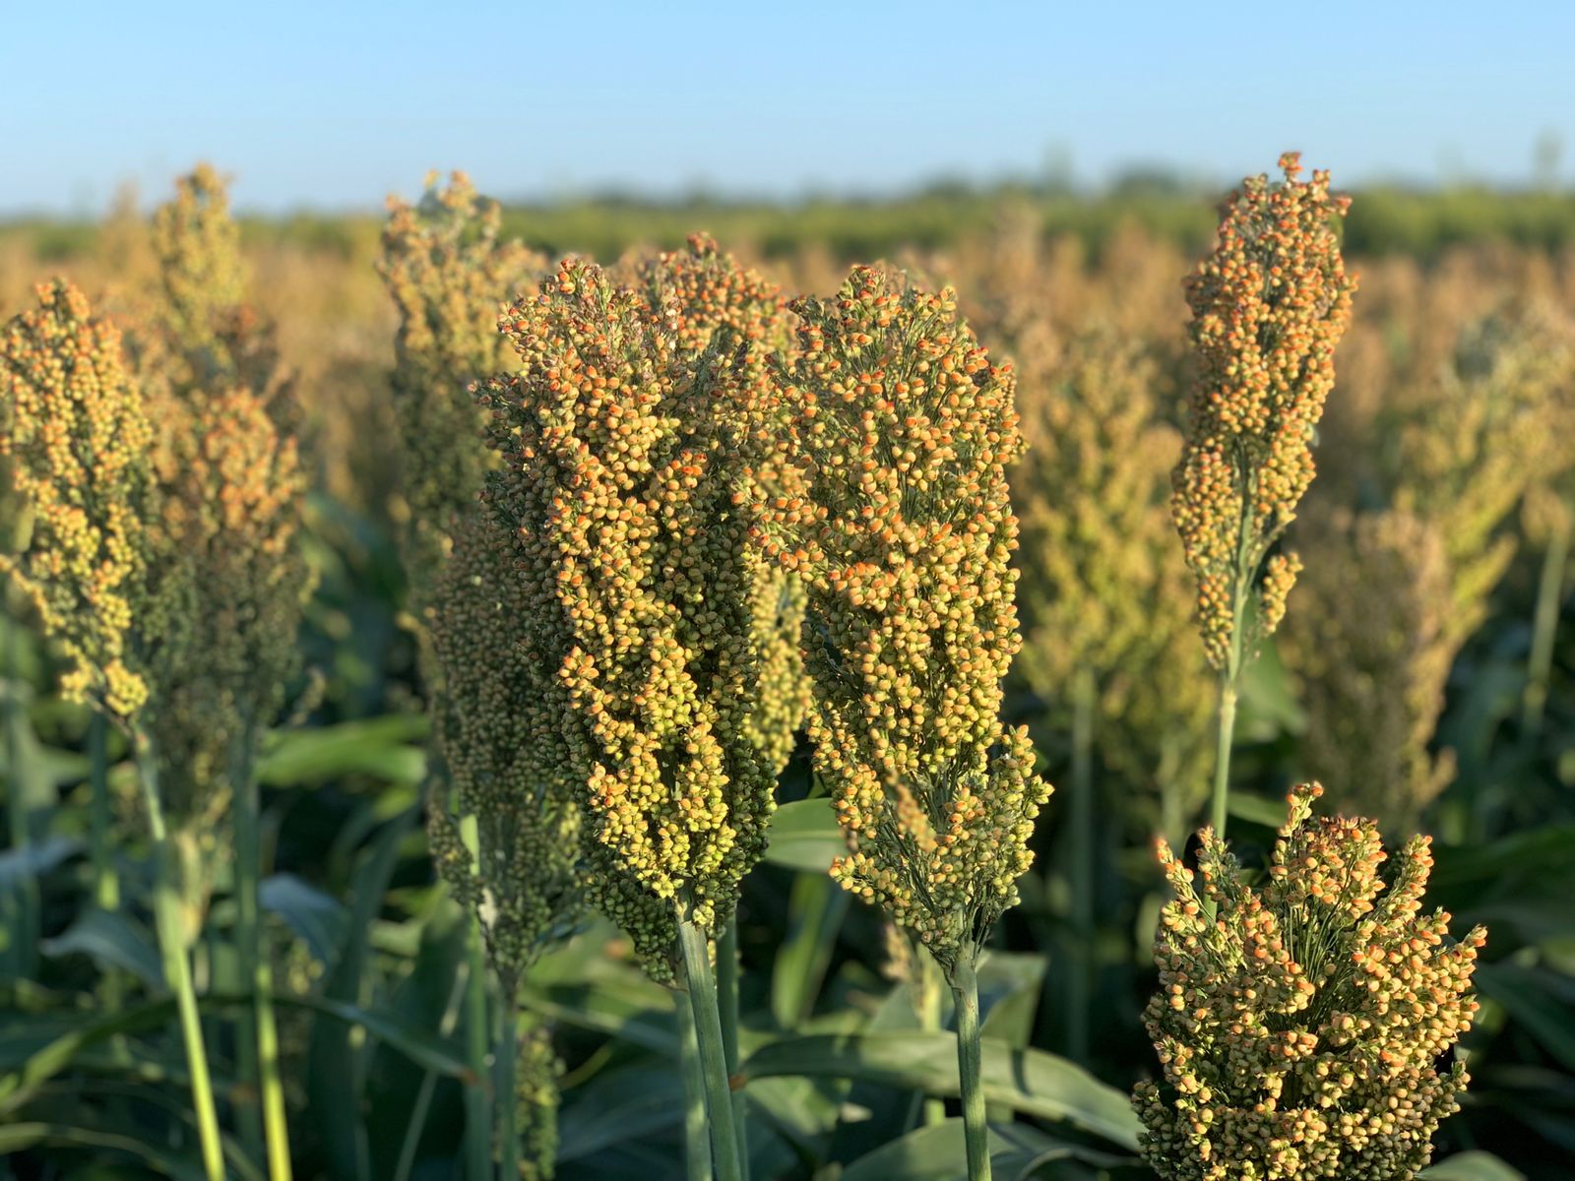





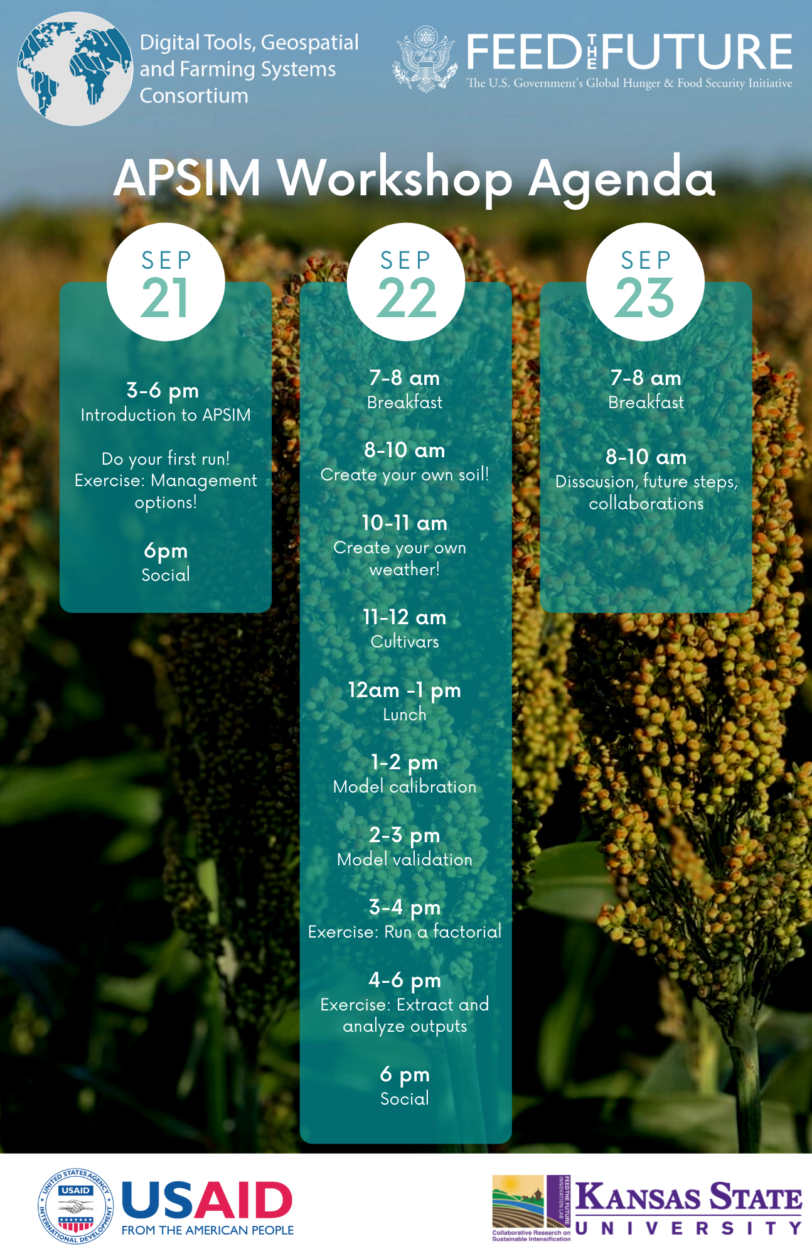
APSIM in the Statasaurus Workshop
Digital Tools, Geospatial
and Farming Systems
Consortium

Slide 2

Crop models are mathematical algorithms that capture the quantitative information of agronomy and physiology experiments in a way that can explain and predict crop growth and development.

Slide 3
Extrapolate data beyond field experimentations
They can simulate many seasons, locations, treatments, and scenarios in a few minutes

Slide 4







Inputs
Inputs
Weather
Soil
Genotype
Management
Model
Model
Crop process
Soil process
Outputs
Outputs
Crop attributes
Soil attributes

Slide 5

Soil
Water
SoilWater
SoilOrganicMatter
Analysis
InitialWater
InitialNitrogen
Soil parameters

Slide 6
Soil
Water
SoilWater
SoilOrganicMatter
Analysis
InitialWater
InitialNitrogen
Soil parameters
Bulk density,
Wilting point
Field capacity
SAT
KL
XF
SWCON
Organic Carbon
Labile portion of OC
Inert portion of OC
pH
Texture
Initial water (% / mm)
Initial NO3 and NH4 (kg/ha)
Crop

Slide 7

Weather
Maximum Tº
Minimum Tº
Precipitation
Radiation
Daily data
You can’t have missing data
Check the units
Latitude is also a requirement
Other variables can be added, but it will not be used in the model
When you are building you own weather file it is important to check that the values are reasonable!

Slide 8
Weather
Maximum Tº
Minimum Tº
Precipitation
Radiation
Daily data
You can’t have missing data
Check the units
Latitude is also a requirement
Other variables can be added, but it will not be used in the model
When you are building you own weather file it is important to check that the values are reasonable!
ºC
ºC
mm
MJ/m²

Slide 9
References

Slide 10
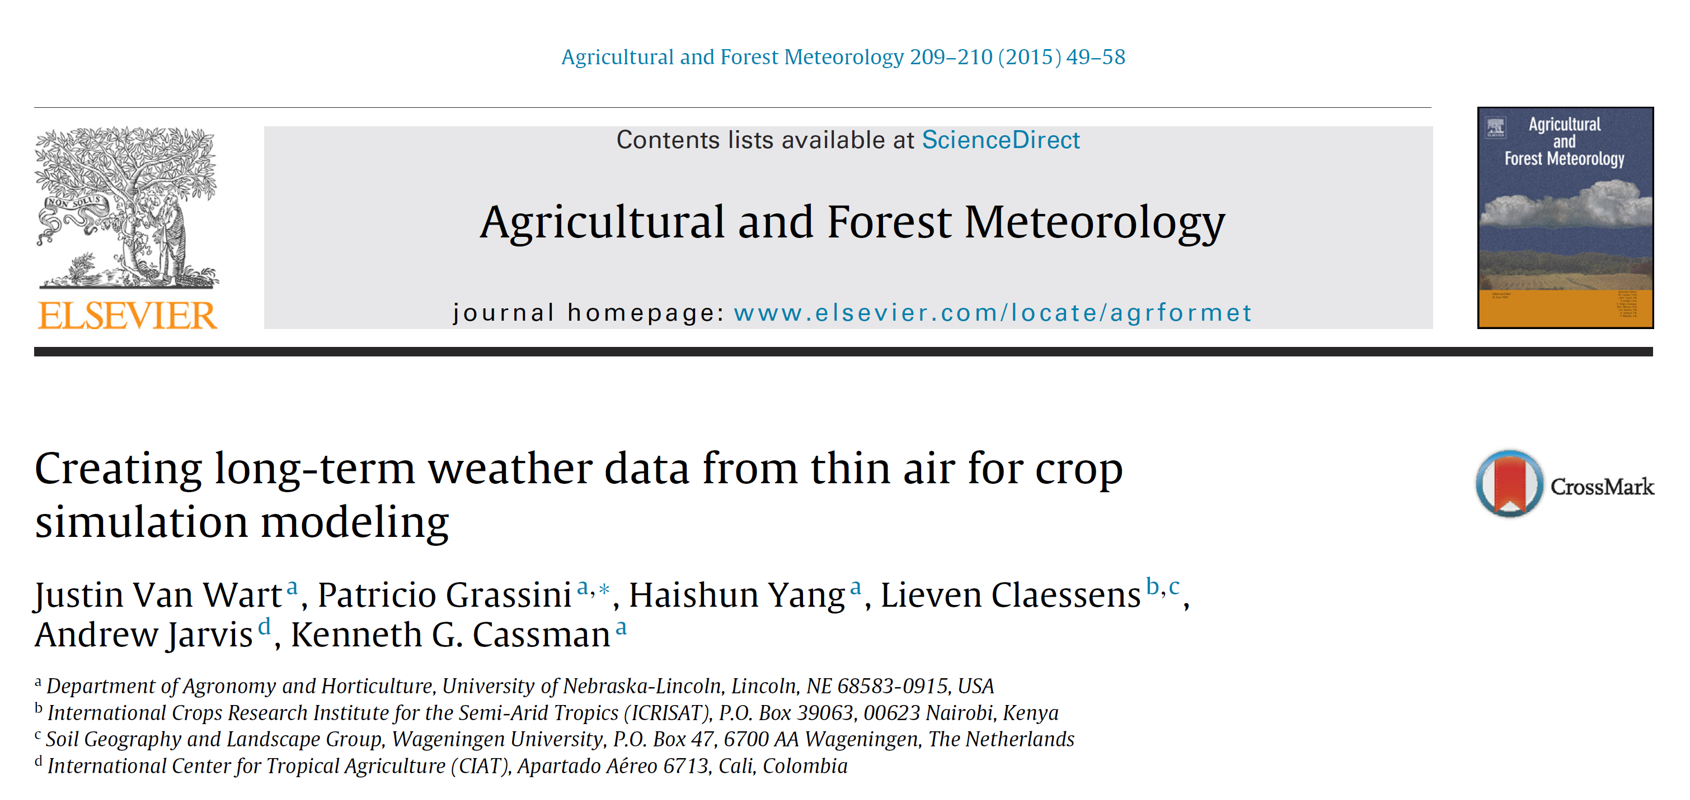
References

Slide 11
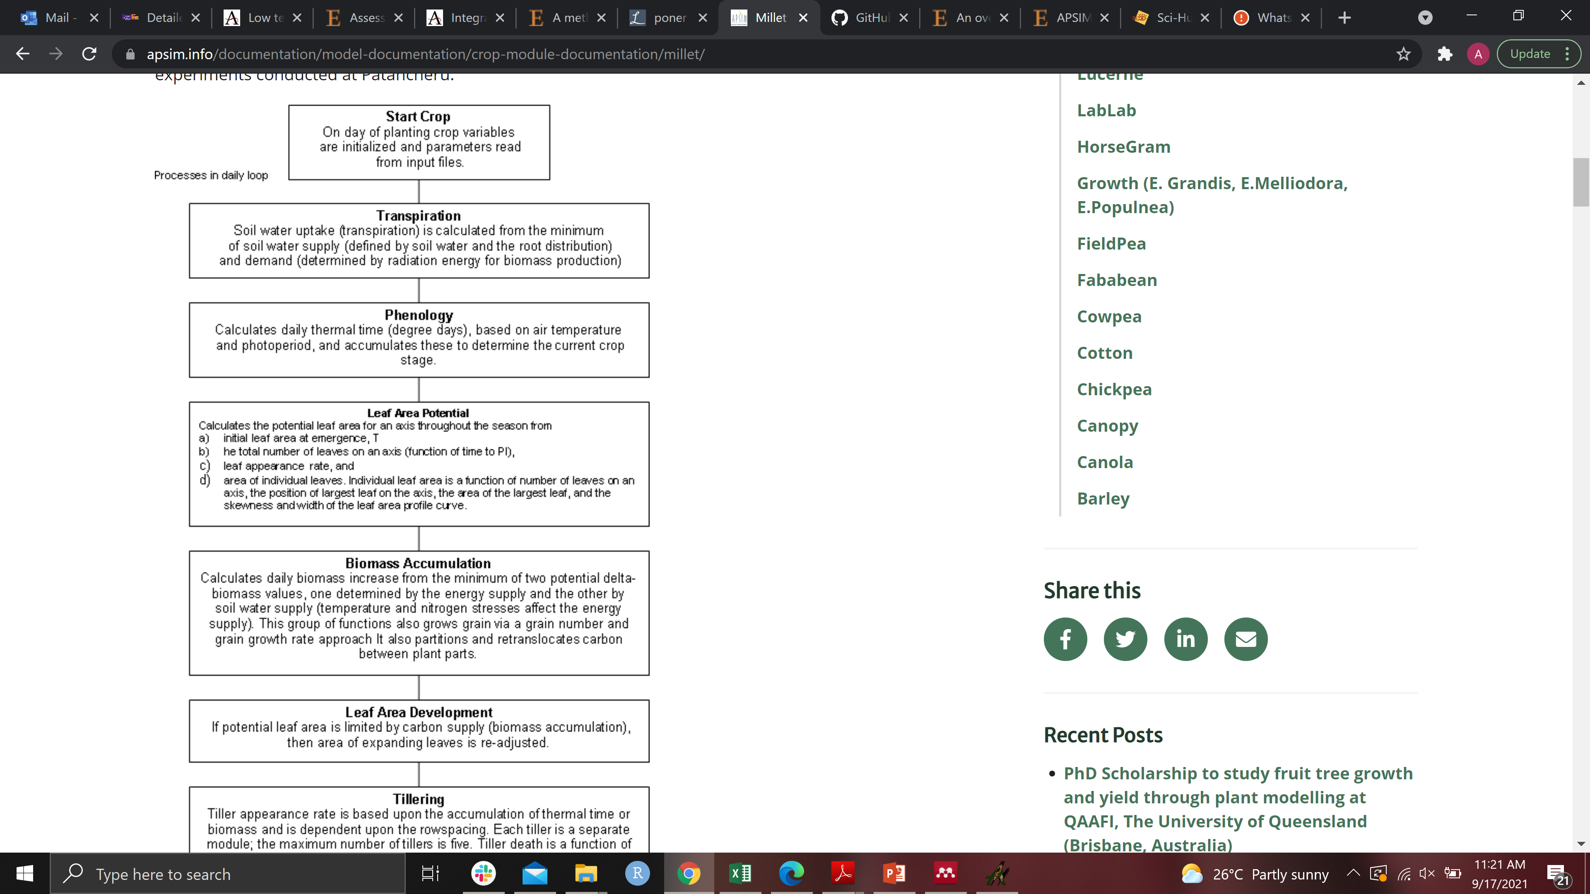

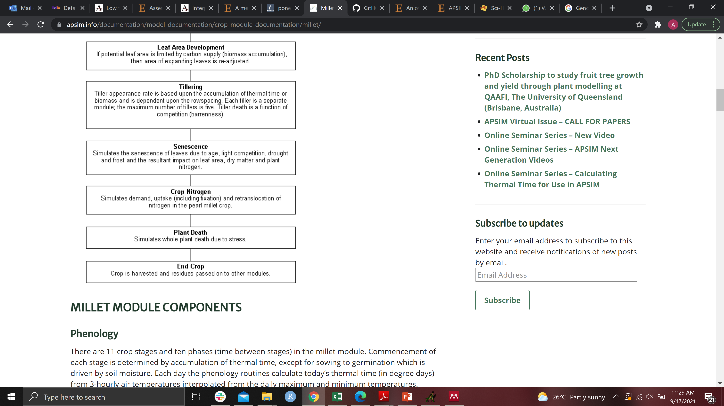
Millet Example
Sequence of actions
Daily
https://www.apsim.info/documentation/model-documentation/crop-module-documentation/millet/

Slide 12
E
Millet Example
Sequence of actions
Daily
Environmental input
https://www.apsim.info/documentation/model-documentation/crop-module-documentation/millet/

Slide 13
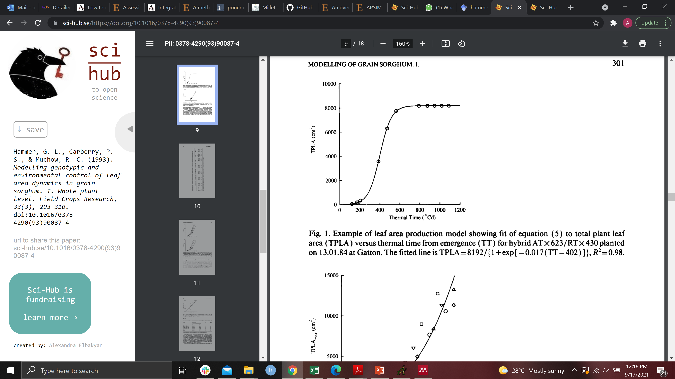
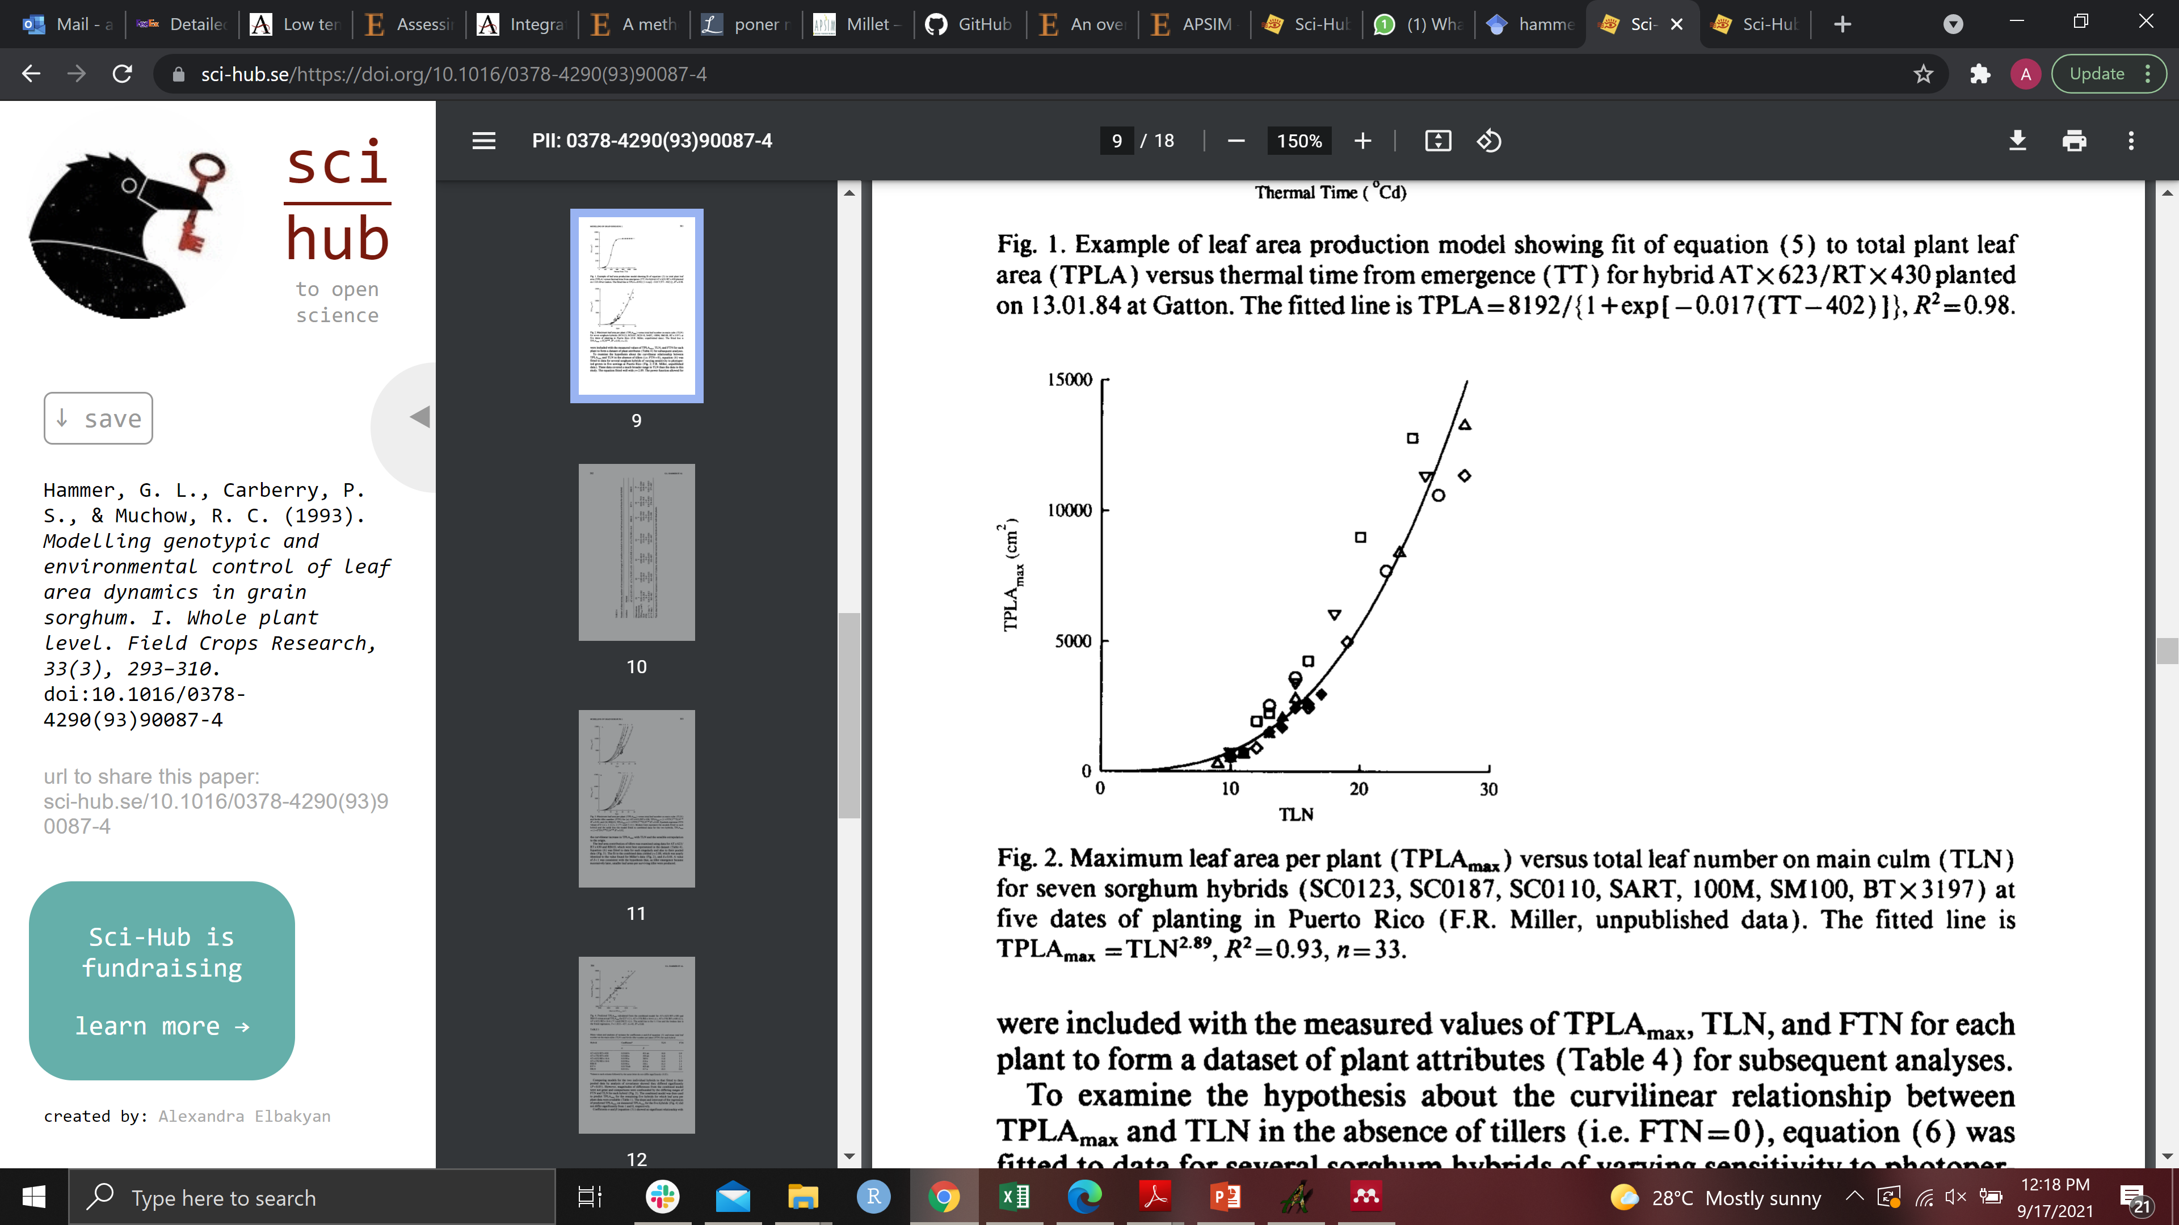
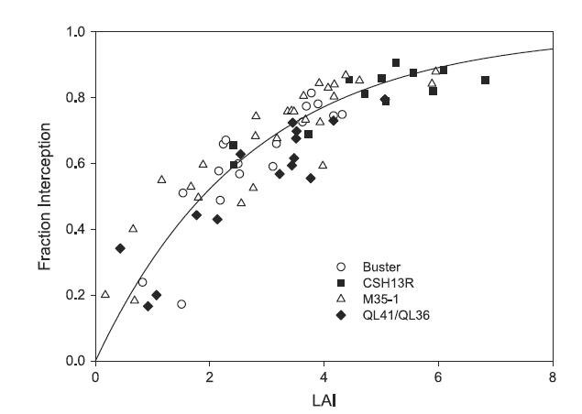
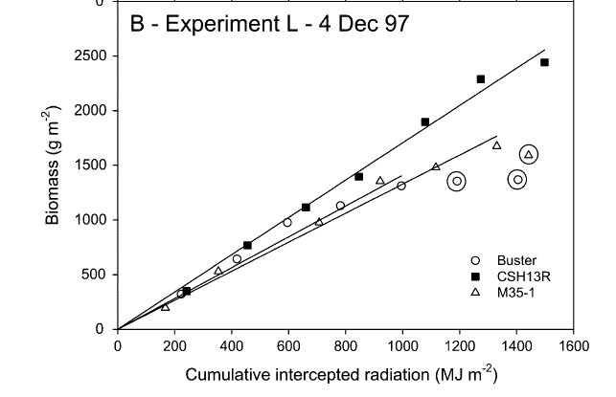
E
Millet Example
Sequence of actions
Daily
Environmental input
Functions behind
(Hammer et al., 1993)
(Hammer et al., 2010)
https://www.apsim.info/documentation/model-documentation/crop-module-documentation/millet/

Slide 14
E
Millet Example
Sequence of actions
Daily
Environmental input
Functions behind
Coefficients
(Hammer et al., 1993)
(Hammer et al., 2010)
https://www.apsim.info/documentation/model-documentation/crop-module-documentation/millet/

Slide 15
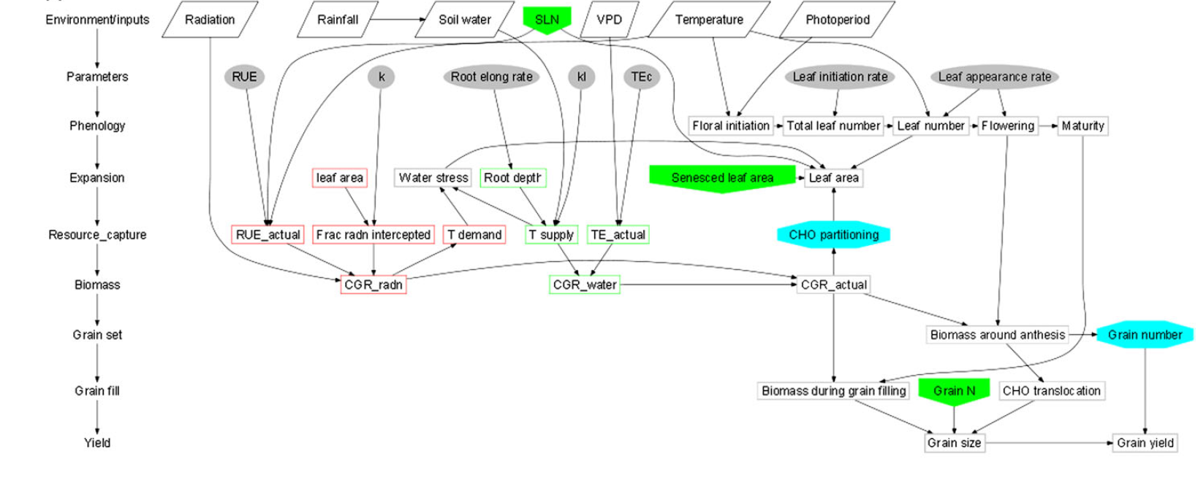
Inputs
Model
Outputs
(Hammer et al., 2010)

Slide 16
Inputs
Model
Outputs
(Hammer et al., 2010)

Slide 17
Inputs
Model
Outputs
(Hammer et al., 2010)

Slide 18
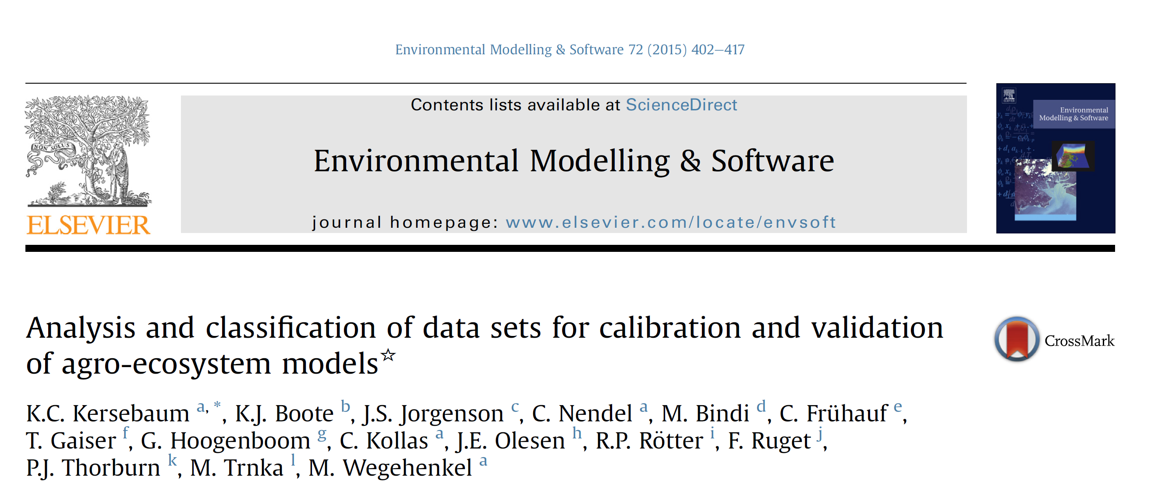
Some Concepts
Calibration
Estimation of crop parameters based upon observed field data
(Adjusting the parameters so they fit)
Accounting & developing generic parameters

Slide 19
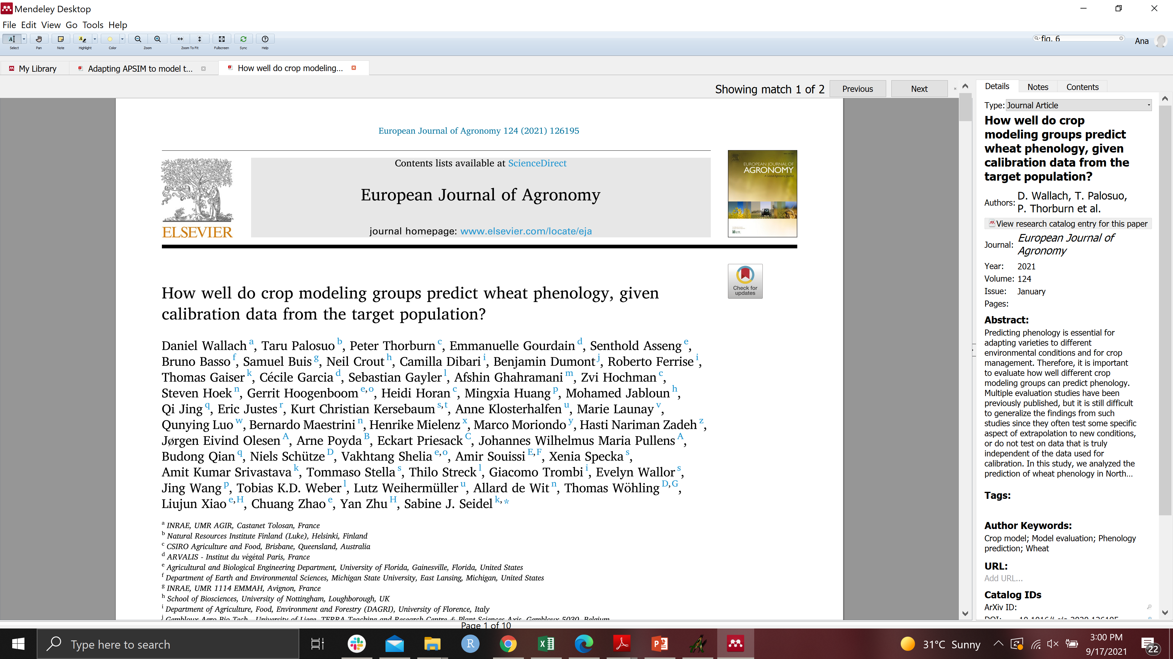

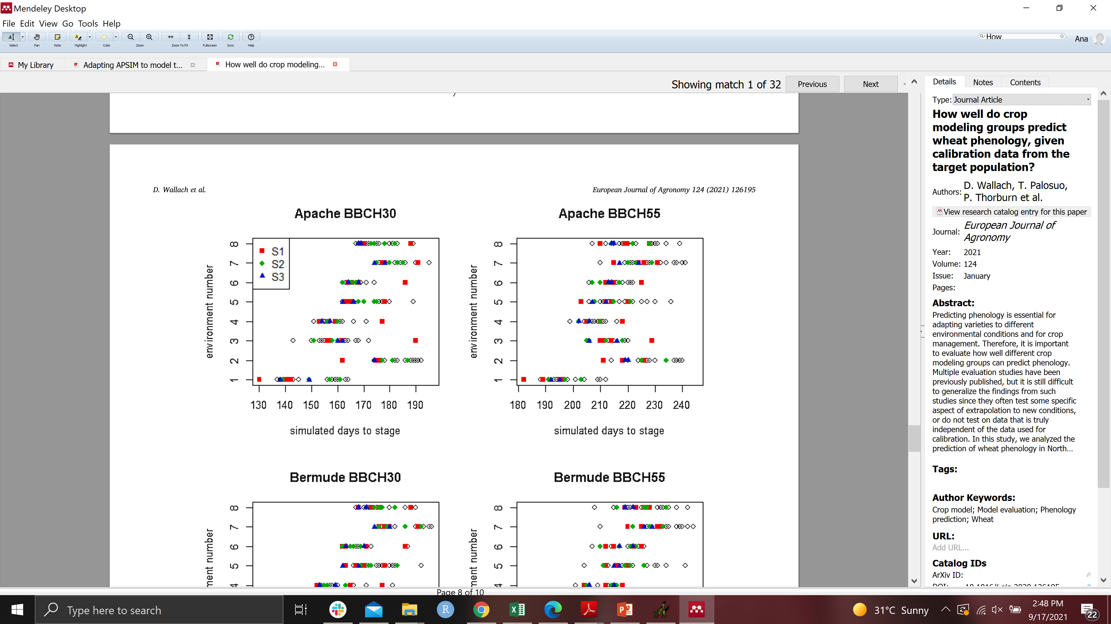
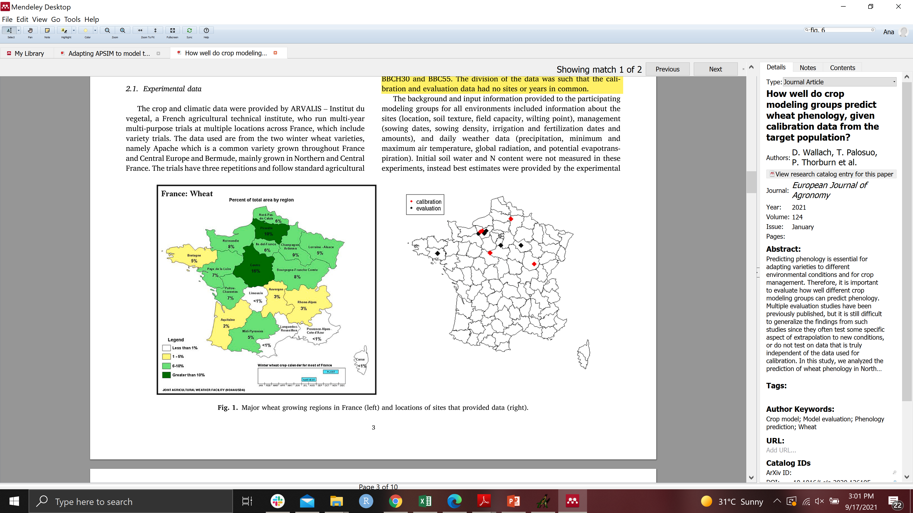
The model calibration is biased.
It depends of the data available and user experience/background.
Example
Wheat phenology in Northern France
27 modeling groups
Predictions by each of the original models for each of the evaluation environments.

Slide 20
Evaluation of the predictive capacity of the model.
Independent data set!
The more diverse the data available the more robust the calibration and validation of the model.
Difference with Testing and Performance of the model (statistics)
“Validation (or falsification if model application is beyond its limits) is the examination whether a model derived from analyses of some systems is capable of describing other systems, or simply, the test of a calibrated model against an independent data set that has not been used for calibration (De Wit, 1982).”

Slide 21

Some concepts more…
Calibration
Validation
Applications of the model
Climate change impact assessment - mitigation
Cropping systems analysis (decision support systems, rotations, Intercropping)
Dynamic simulation modeling (include economics and human behaviour)
Phenotype simulations – Breeding - GxE – quantitative loci representations – what if
Simulated yield gaps and potentials
Yield forecasting
Linking with remote sensing tools
Linking with 3-D Crop Models
Environment characterization, description of Seasonal Variability and Spatial Variability
Natural Resources Management (C cycle, soil degradation, N leaching, soil salinization, acidification , compaction erosion) integration of models variables

Slide 22
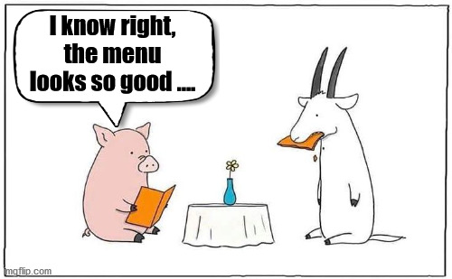
Golomb (1971): “Confusing models with reality is like to go to a restaurant and eating the menu”.

Slide 23
Thanks, and let’s do some exercises!

